Slide 1
W205 Project Update
Streaming Twitter Data
to analyze
Political Sentiment in the U.S.
Shuang Chan
David Skarbrevik

Slide 2
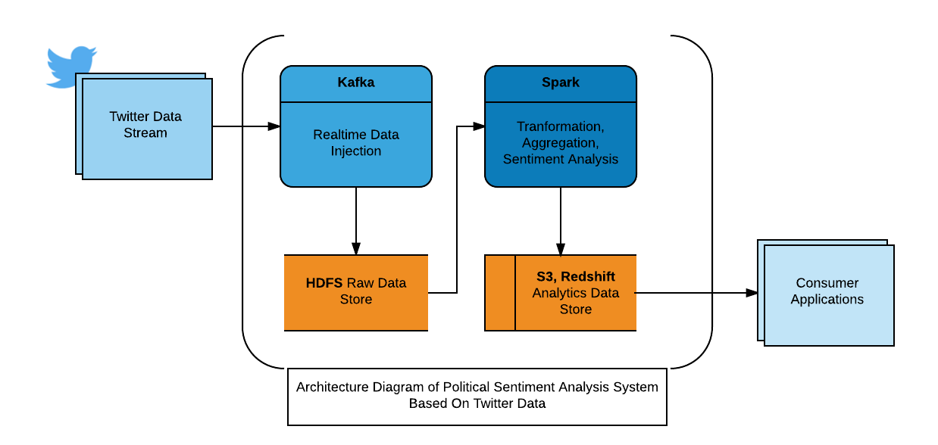
Overview of Project
Project Architecture
Project Purpose
Average positive approval
Election over
(Twitter REST API analysis)
Change over time
(Twitter Streaming API)

Slide 3
What we’ve done / doing

Slide 4
What’s left to do

Slide 5
Timeline for Completion
Time frame | 11/22/2016 | 11/27/2016 | 11/29/2016 | 12/4/2016 | 12/6/2016 (final deadline)
Goals | Stream data being stored in HDFS schema | Sentiment Analysis (spark) | Store analysis in S3 | Front facing app / way for consumers to download | Presentation and final commit to github

